Slide 1
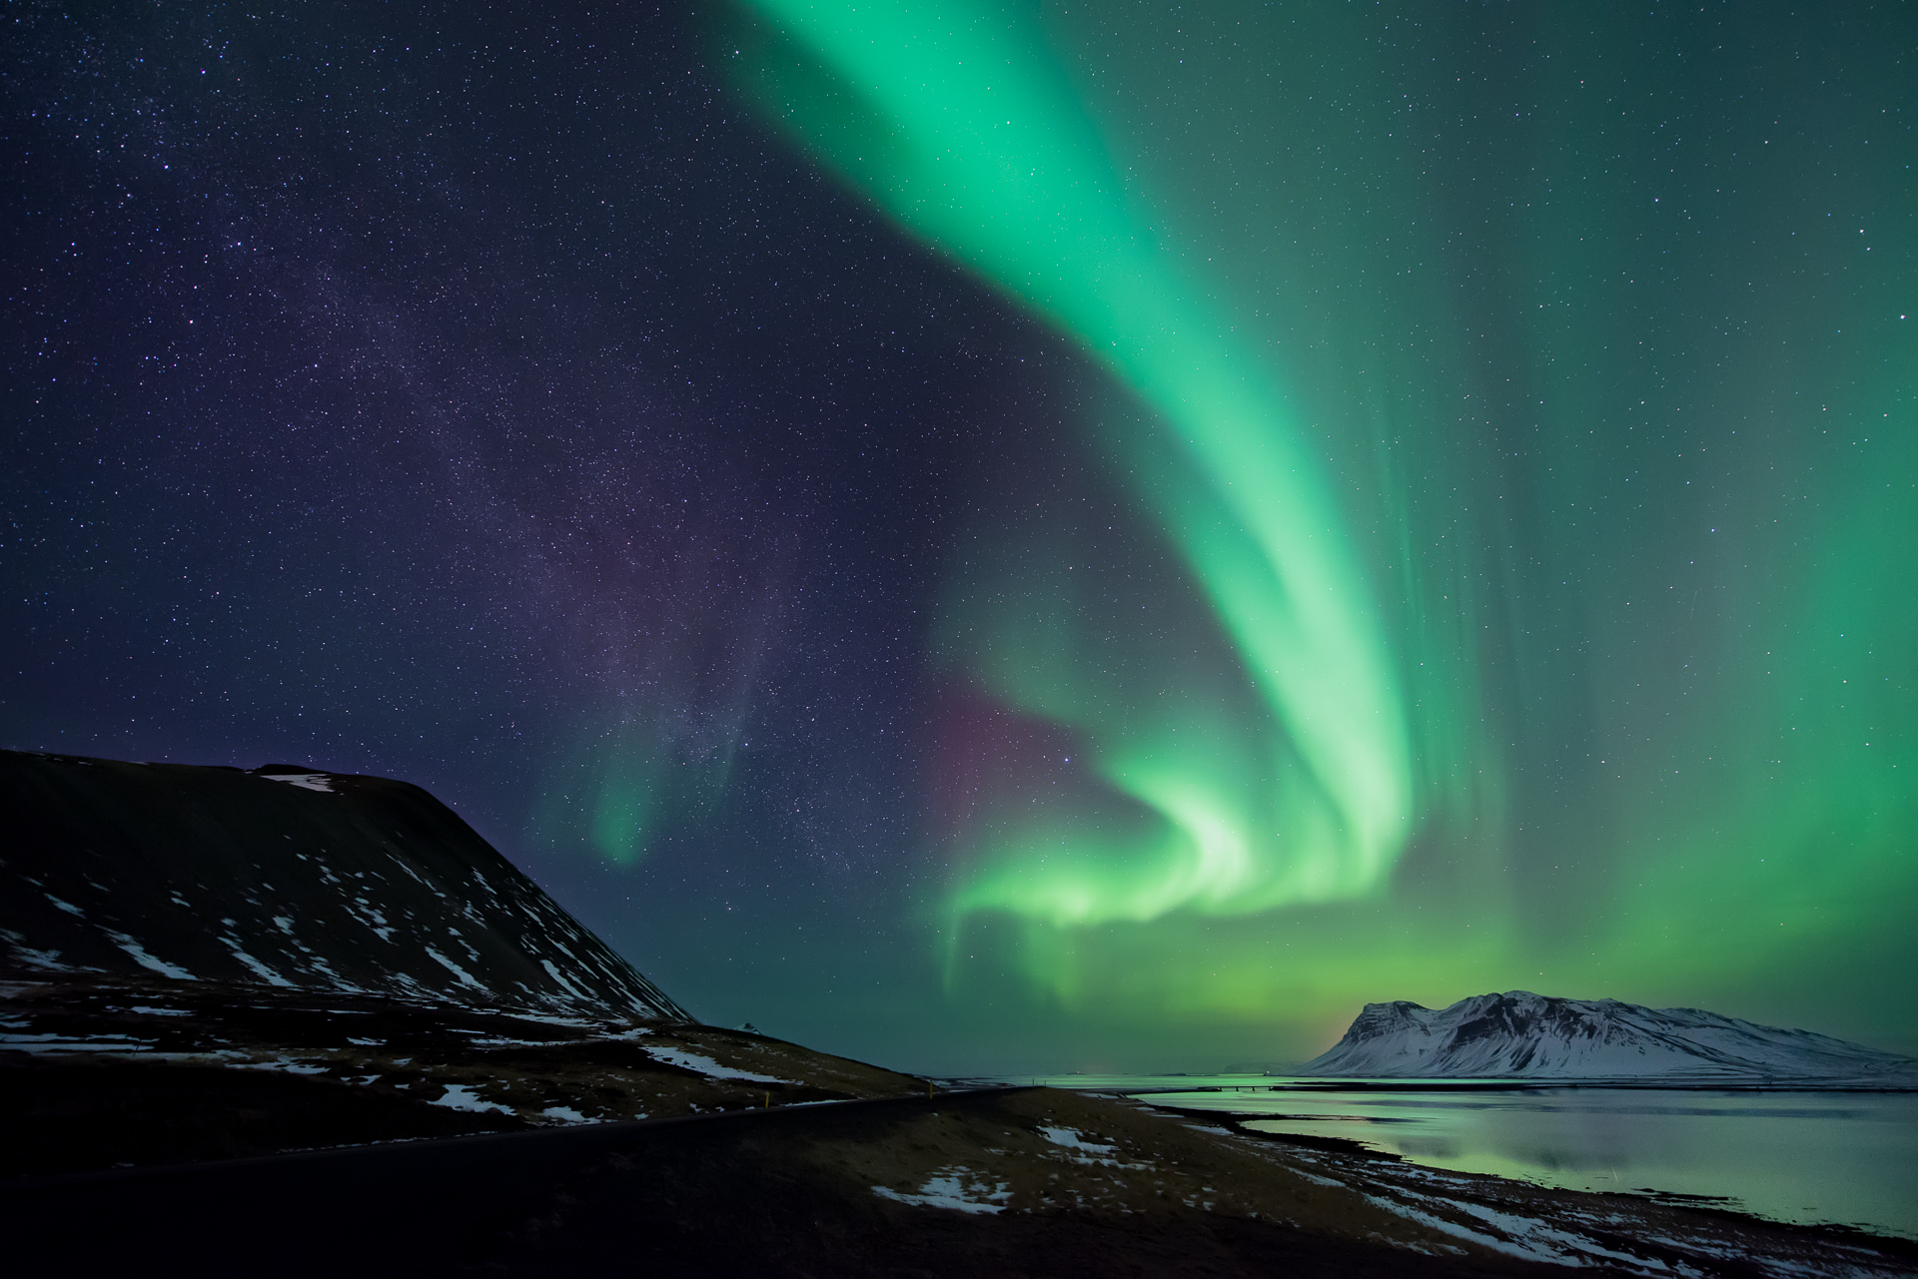
This is the first slide

Slide 2

This is the second slide

Slide 3

This is the third slide

